Slide 1
Semantic Analyzer
Rayansh Srivastava - RA2011026010069
Himanshu - RA2011026010084

Slide 2
Abstract
A semantic analyzer is a critical component of modern software development, used to ensure that programming code is semantically correct and adheres to the rules and constraints of the programming language.
The primary goal of a semantic analyzer is to perform a deep analysis of code, checking for inconsistencies in types, declarations, and usage of variables, and verifying that functions and procedures are used correctly. It goes beyond simple syntax checks and analyzes the intent behind the code and the context in which it is being used.
The benefits of semantic analysis are many, including improved code quality, faster development times, better performance, enhanced security, and more accurate program understanding. By catching errors early in the development process and ensuring adherence to programming language standards, semantic analyzers can save developers time and effort, reduce the likelihood of bugs and errors, and help organizations build more reliable and secure software systems.

Slide 3
Introduction
In computer programming, a semantic analyzer (a semantic checker or semantic parser) is a software tool that analyzes the meaning and context of programming code.
The role of a semantic analyzer is to ensure that the code follows the rules and constraints of the programming language and to detect any semantic errors that the syntax checker might not catch. It performs a deep analysis of the code, looking for inconsistencies in types, declarations, and usage of variables, and checking that functions and procedures are used correctly.
The output of a semantic analyzer is usually a high-level abstract representation of the code that is easier to understand and manipulate by other software tools, such as compilers, interpreters, or code generators. The semantic analyzer is a crucial component of the compilation process, translating human-readable code into machine-executable code.
To further elaborate, a semantic analyzer can be thought of as a language expert that can understand the intent behind the code and the context in which it is being used. It goes beyond simple syntax checks and analyzes the meaning of the code, ensuring that it conforms to the rules and semantics of the programming language.

Slide 4
Problem Statement
The problem statement for a semantic analyzer is to develop an effective tool that can accurately detect and report semantic errors in software code. Semantic errors are errors that occur when the code is syntactically correct but does not behave as expected, often due to incorrect use of variables, data types, or program logic. These errors can be difficult to detect and can cause significant problems for software development teams, leading to wasted time and resources, and even software failures.The challenge in developing a semantic analyzer lies in accurately identifying these semantic errors, which requires a deep understanding of the programming language syntax, as well as the context in which the code is being used. Additionally, the semantic analyzer must be able to report these errors in a clear and understandable format, along with suggestions for how to fix them.Moreover, the semantic analyzer must be scalable and adaptable to different programming languages and development environments. It must also be efficient, with fast processing times and low resource requirements, to ensure that it can be used effectively in large-scale software development projects.

Slide 5
Objectives
The objectives of building a semantic analyzer include:
1. Accurately detecting and reporting semantic errors in software code: The primary objective of a semantic analyzer is to identify and report semantic errors in software code. The tool should be able to understand the context in which the code is being used and detect errors that may not be apparent from the code's syntax.
2. Providing clear and understandable error reports: The semantic analyzer should provide error reports that are easy to understand, with suggestions for how to fix the errors.
3. Supporting multiple programming languages: The semantic analyzer should be adaptable to different programming languages and development environments, enabling it to be used effectively in a variety of software development projects

Slide 6
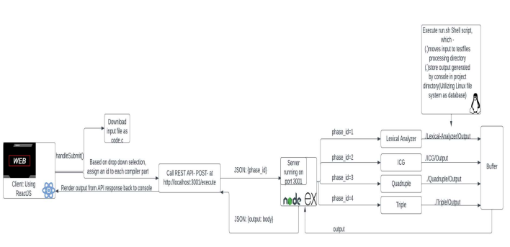
Architecture Diagram

Slide 7
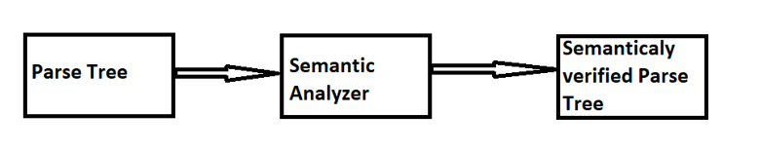
Component Diagram for Semantic analyzer

Slide 8
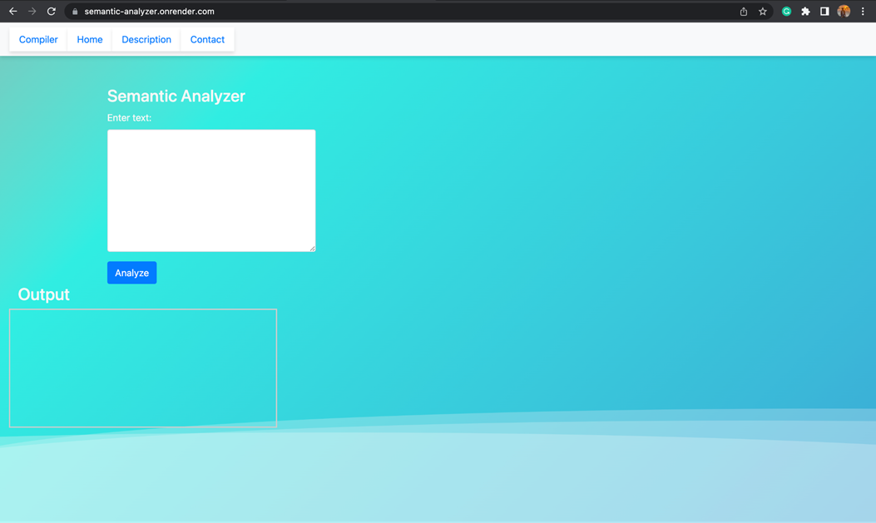
Frontend

Slide 9
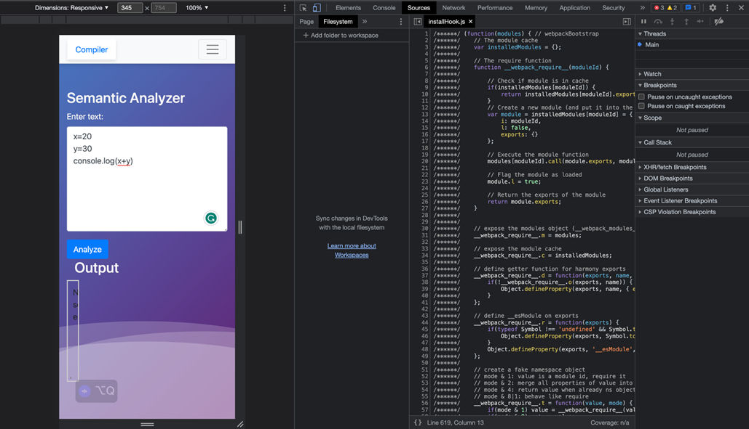
Backend

Slide 10
Results
A semantic analyzer is a crucial tool for software development teams, enabling them to detect and report semantic errors in code. By providing suggestions for fixing errors and supporting multiple programming languages, the analyzer can improve the overall quality and reliability of software systems. However, developing an accurate, efficient, and scalable semantic analyzer requires significant expertise and resources.

Slide 11
Conclusion
In conclusion, a semantic analyzer is a powerful tool for software developers to identify and fix semantic errors in their code. It uses advanced techniques such as natural language processing, machine learning, and rule-based approaches to analyze the syntax and context of the code and identify semantic errors that may not be caught by traditional debugging tools.
While building a semantic analyzer can be a challenging and complex process, it offers many benefits for software developers, including improved code quality, faster development cycles, and better collaboration among team members. Moreover, as software systems become more complex and diverse, the need for accurate and efficient semantic analysis is only going to increase.

